Slide 1
Software patterns in Delphi
presented by
Peter Thönell
www.batsoft.com.au
peter@batsoft.com.au
https://github.com/ADUG-Perth/Symposium-2021

Slide 2
I have lost count of how many Delphi developers said these exact words:
“Oh, yeah… software patterns.
I don’t know patterns.
That’s advanced programming.
I know I should learn patterns
…but I haven’t got around to it.”
We all use patterns when writing software,
whether or not we’re aware of them.

Slide 3
What are patterns?
Software design patterns are:
recurring techniques that have been named.

Slide 4
Communication: Concise terms
“Yesterday I bought a new four wheeled thing that one travels in.”
“Yesterday I bought a new car.”
Clearly the second statement:
Is simpler and more concise.
Conveys the concept of a four wheeled thing that... car.
In essence, that is what patters are: terms that convey concepts, sometimes complex concepts, sometimes simple.

Slide 5
Conceptualisation: Building blocks
When combining concepts, the result will be an even more complex.
But if each concept is distinct and named, then
our architecture remains tidy,
in mind, words, diagrams, code…
It’s like having conceptual building blocks.

Slide 6
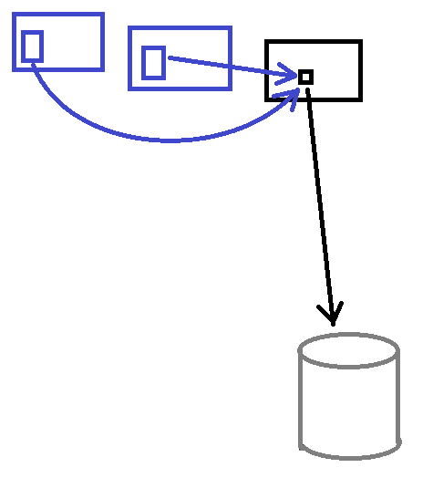
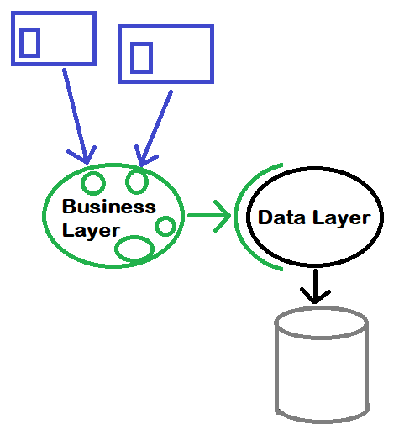
Consider using a proper business layer
Data aware
Business layer

Slide 7
New ideas: Don’t reinvent wheels
Other developers have found solutions and techniques that could be just what we need.
Why not learn them?

Slide 8
Example
“It’s a singleton factory that produces TPerson multitons with subscribers.”
(At the end of this presentation, that will hopefully make sense.)
Disclaimer:
This is overkill, but this is a presentation and I’m trying to make a point.

Slide 9
Criticisms

Slide 10
1. Other languages don’t need many patterns
Different tools – different strengths.
Other language paradigms have their own patterns (idioms). Patterns still exist, just different patterns.

Slide 11
2. Patterns are used because libraries are incomplete
Some patterns:
are part of libraries
ex. containers (TList<>, TDictionary<>)
become part of the language
ex. abstractions (interfaces, base classes)
we use as a natural part of our process
ex. composites (forms/frames with controls and other components)

Slide 12
3. Patterns are too rigid
Understand the concept of a pattern.
Don’t get hung up on “the correct implementation”.

Slide 13
4. People use complex patterns unnecessarily.
Yes. People often misuse recently discovered goodies.
That’s a problem with people, not goodies.
So, when should you use patterns?
When appropriate!
Patterns are useful tools.
Simply using patterns does not make one good architect, but
good architects know many patterns and how to use them.

Slide 14
Singleton: Global variable
interface
type
TGlobal = class
public
UserID : integer;
UserName: string;
end;
var
Global: TGlobal;

Slide 15
Singleton: Global function
interface
type
TGlobal = class
public
UserID : integer;
UserName: string;
end;
function Global: TGlobal;
implementation
var
_Global: TGlobal = nil;
function Global: TGlobal;
begin
if not Assigned(_Global) then
_Global := TGlobal.Create;
Result := _Global;
end;

Slide 16
Singleton: Static class
interface
type
Global = class
public
class var UserID : integer;
class var UserName: string;
end;

Slide 17
Let’s look at some code now…

Slide 18
Delphi events are single call-backs

Slide 19
Subscriber/Observer pattern
Any number of observers can subscribe their call-back methods.

Slide 20
Multiton
There can be multiple instances of a multiton class, but
each instance must uniquely represent its own “thing”.

Slide 21
Factory
If a shoe factory creates shoes
and a car factory creates cars,
then an object factory creates objects.

Slide 22
Abstract factory
A container of actual (concrete) factories.
Pretends to be a factory,
but actually delegates work to concrete factories.

Slide 23
Example
“It’s a singleton factory that produces TPerson multitons with subscribers.”
Does this make sense now?

Slide 24
Memento
Also known as Undo/Redo functionality.
Save the state. Later, can restore the state.

Slide 25
Other patterns
Decorators
Façade
Dependency injection
Flyweight
Chain of responsibility
Command

Slide 26
Summary
We all use patterns.
Bigger toolbox → more versatility.
Less reinventing of wheels.

Slide 27
Thank you !
www.batsoft.com.au
peter@batsoft.com.au
GetIt: BatSoft Library
https://github.com/ADUG-Perth/Symposium-2021

